Slide 1
Photomicrographs of Plant foods
Cilantro (Coriander)
Permission to reproduce original photomicrographs used to make this collection may be obtained from
Dr. David O. Norris at
david.norris@colorado.edu

Slide 2
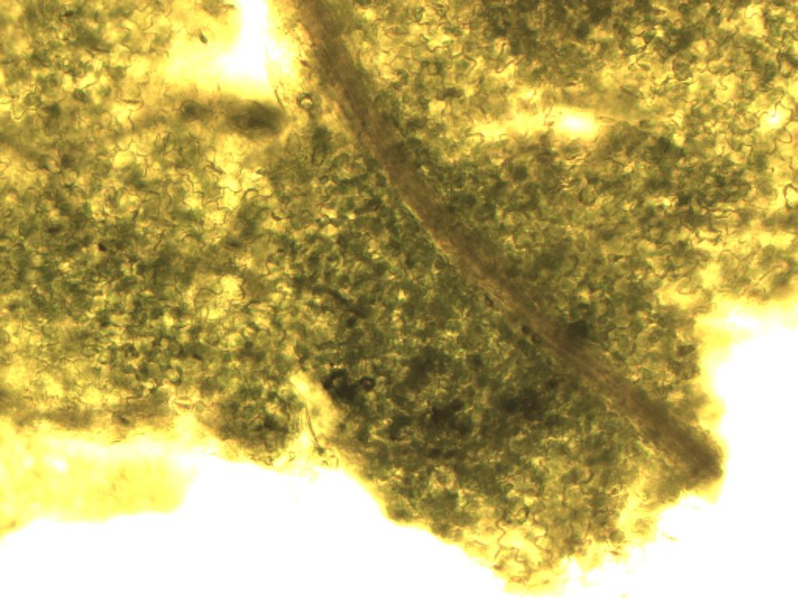
Notes:
131. Coriandrum sativum L. Coriander = Cilantro. Fresh leaf fragment showing clear epidermal cells (black arrow), greenish photosynthetic parenchymal cells, and a vascular vein (white arrow), 10X.

Slide 3
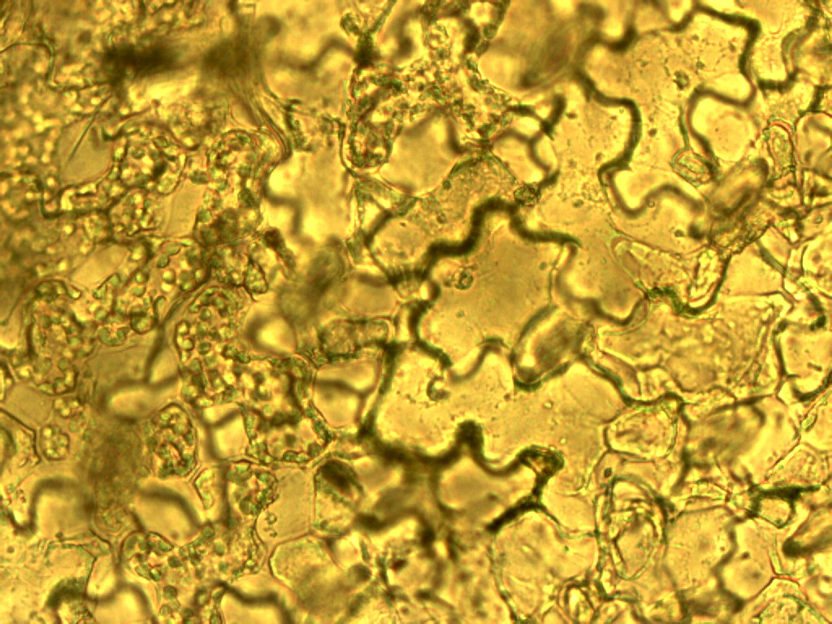
E
E
E
Notes:
132. Coriander (Cilantro). Photosynthetic cells with green chloroplasts (arrows); epidermal cells lacking chloroplasts (E), 40X.

Slide 4
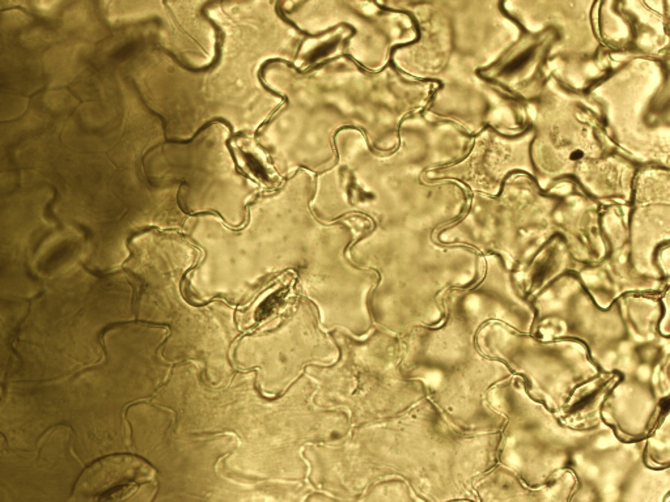
Notes:
134. Coriander (Cilantro). Jig-saw puzzle piece-shaped epidermal cells; stomata (arrows), 40X.

